Slide 1

Spring 2023
CSE 427 (Digital Image Processing)
Topic - 3: Color Models
Course Teacher:
Naznin Sultana
Associate Professor
Department of Computer Science and Engineering
Daffodil International University

Slide 2
Introduction
A color model is an abstract mathematical model describing the way colors can be represented as tuples of numbers, typically as three or four values or color components.
Examples:
  RGB (red, green, blue) color model
  CMY (cyan, magenta, yellow) color model
  HSV (hue, saturation, value) color model
  HLS (hue, lightness, saturation) color model
  ◦
  ◦
  ◦
Hardware-oriented
User-oriented

Slide 3
The RGB Color Model
The name of the model comes from the initials of the three additive primary colors red, green and blue.
The RGB color model is an additive color model in which red, green, and blue light are added together in various ways to reproduce a broad array of colors.

Slide 4
The RGB Color Model…
A color in the RGB color model is described by indicating how much of each of the red, green and blue is included.
The color is expressed as an RGB triplet (r, g, b), each component of which can vary from zero to a defined maximum value.
If all the components are at zero the result is black; if all are at maximum, the result is the brightest representable white.

Slide 5

The RGB Color Model…
For example, the full intensity red is written in the different RGB notations as:
Notation | RGB triplet
Arithmetic | (1.0, 0.0, 0.0)
Percentage | (100%, 0%, 0%)
Digital 8-bit per channel | (255, 0, 0)
A typical RGB color selector in a graphic software. Each element ranges from 0 to 255.

Slide 6
The RGB Color Model…
In the 24-bit RGB color representation, color values for each pixel encoded in a 24 bits per pixel fashion in which three 8-bit unsigned integer (0 through 255) represent the intensities of red, green and blue. 2⁸ = 256 levels of each of these three colors can therefore be combined to give a total of 16,777,216 mixed colors (256 x 256 x 256).
In the 32-bit RGB color representation, an extra 8-bit channel for transparency is included to 24-bit RGB representation. The transparency channel is commonly known as the alpha channel, so the format is named RGBA.

Slide 7
The RGB Color Model…
RGBA is not a distinct color model.
It is only a representation that integrates transparency information along with the color information.
This extra channel allows for blending of the image with another.
Many assume that 32-bit RGB color produces 4,294,967,296 distinct colors.
In reality, 32-bit RGB color actually refers to 24-bit RGB color.

Slide 8
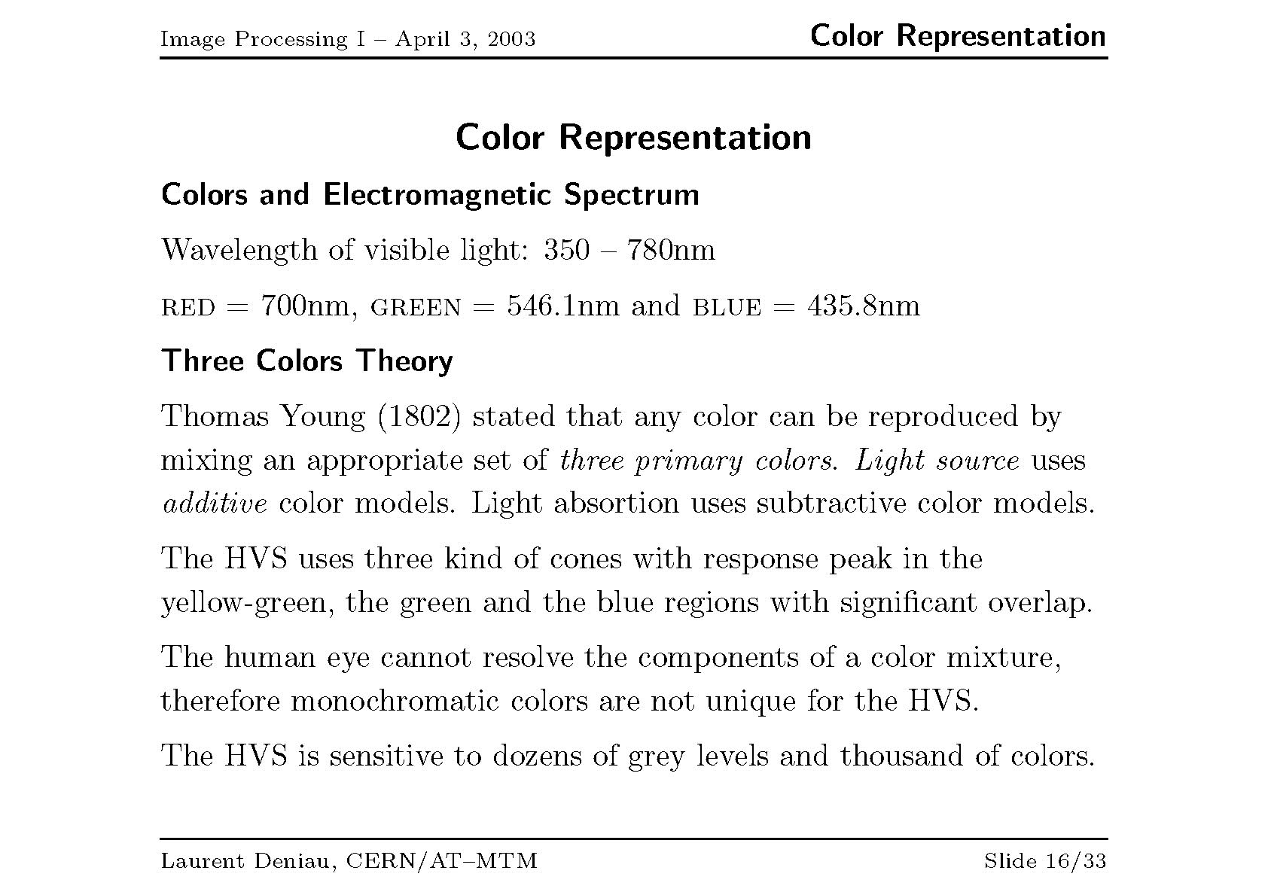

Slide 9
Color Models
Color models attempt to mathematically describe the way that humans perceive color
The human eye combines 3 primary colors (using the 3 different types of cones) to discern all possible colors.
Colors are just different light frequencies
  red – 700nm wavelength
  green – 546.1 nm wavelength
  blue – 435.8 nm wavelength
Lower frequencies are cooler colors

Slide 10
Primary Colors
Primary colors of light are additive
  Primary colors are red, green, and blue
  Combining red + green + blue yields white
Primary colors of pigment are subtractive
  Primary colors are cyan, magenta, and yellow
  Combining cyan + magenta + yellow yields black

Slide 11
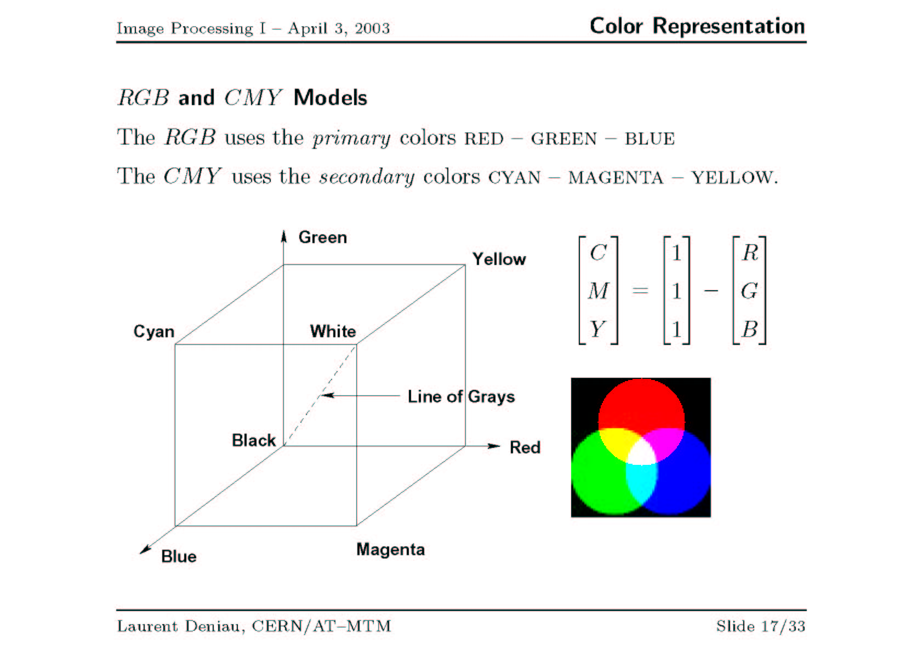

Slide 12
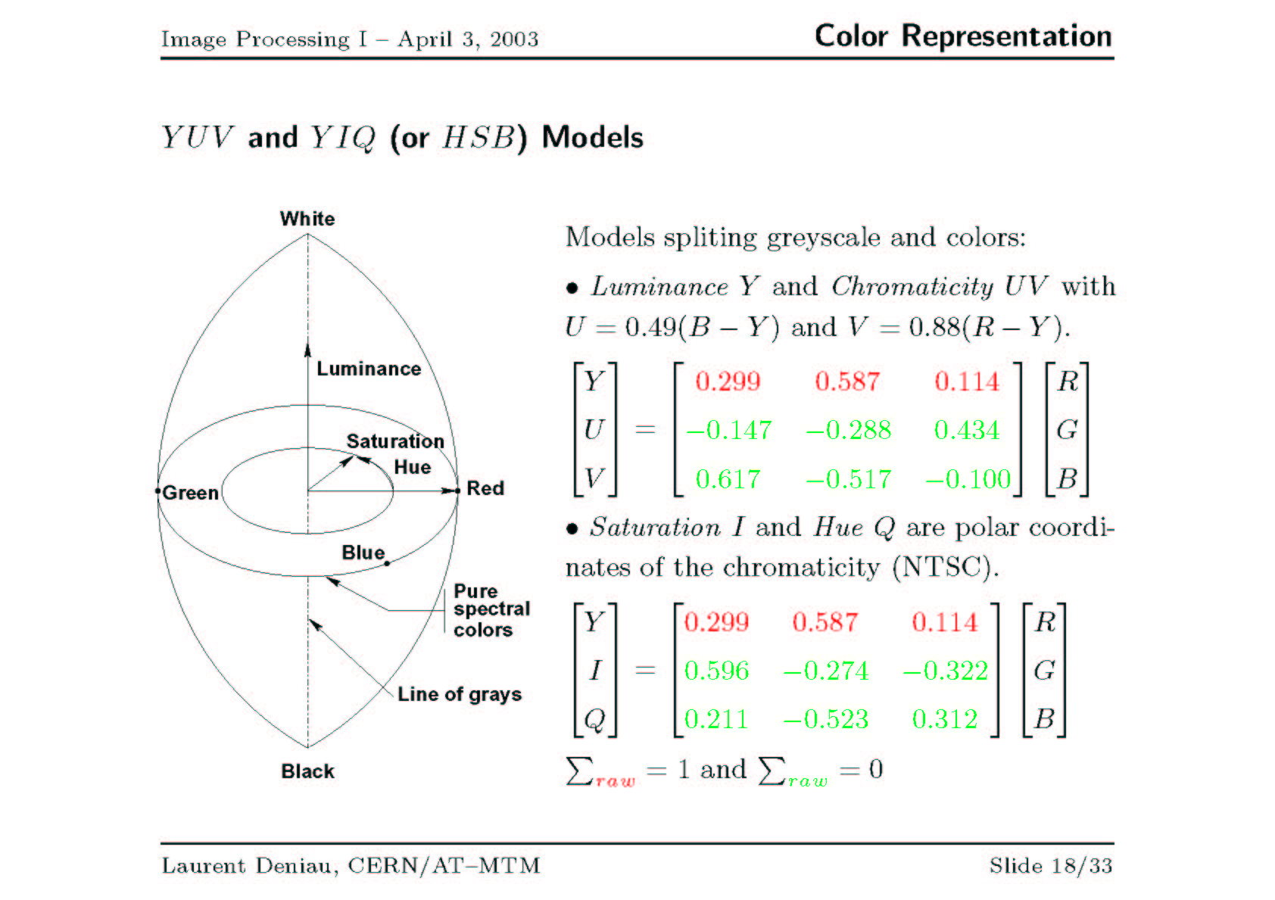

Slide 13
YIQ Color Model
Luminance (Y), Inphase (I), and Quadrature (Q)
Used for TV broadcasts – backward compatible with monochrome TV standards
Luminance is BW component
Human visual system is more sensitive to changes in intensity than in color.
In NTSC, bandwidth allocation of YIQ is 4MHz, 1.5 MHz, and 0.6 MHz respectively.
Y 0.299 0.587 0.144 R
I = 0.596 -.275 -.321 G
Q 0.212 -.528 0.311 B

Slide 14
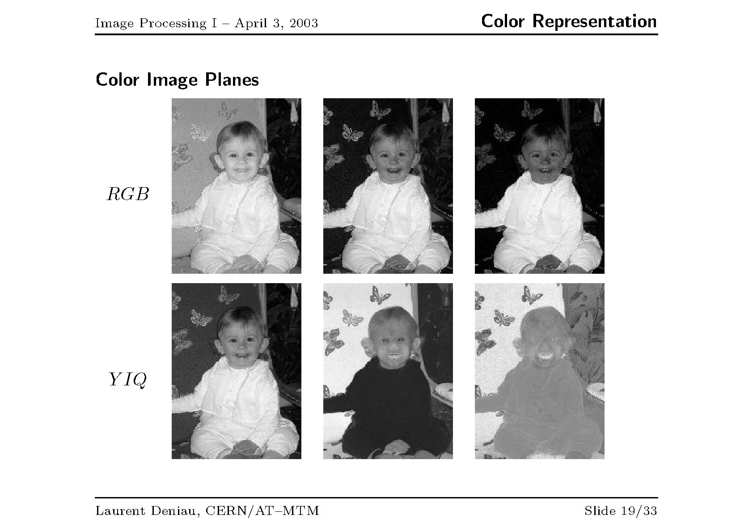

Slide 15
HSI Color Model
Based on human perception of colors. Color is “decoupled” from intensity.
  HUE
    A subjective measure of color
    Average human eye can perceive ~200 different colors
  Saturation
    Relative purity of the color. Mixing more “white” with a color reduces its saturation.
    Pink has the same hue as red but less saturation
  Intensity
    The brightness or darkness of an object

Slide 16
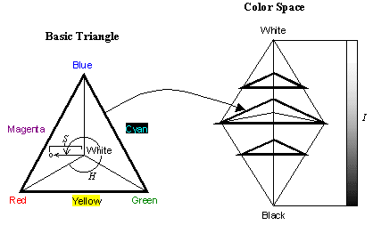
HSI Color Model
In color image processing, RGB images are often converted to HSI and then the I component is manipulated. The image is then converted back to RGB.

Slide 17
HSI Color Model
Hue is defined as an angle
  0 degrees is RED
  120 degrees is GREEN
  240 degrees is BLUE
Saturation is defined as the percentage of distance from the center of the HSI triangle to the pyramid surface.
  Values range from 0 to 1 (0 is achromatic and 1 is fully saturated)
Intensity is denoted as the distance “up” the axis from black.
  Values range from 0 to 1

Slide 18
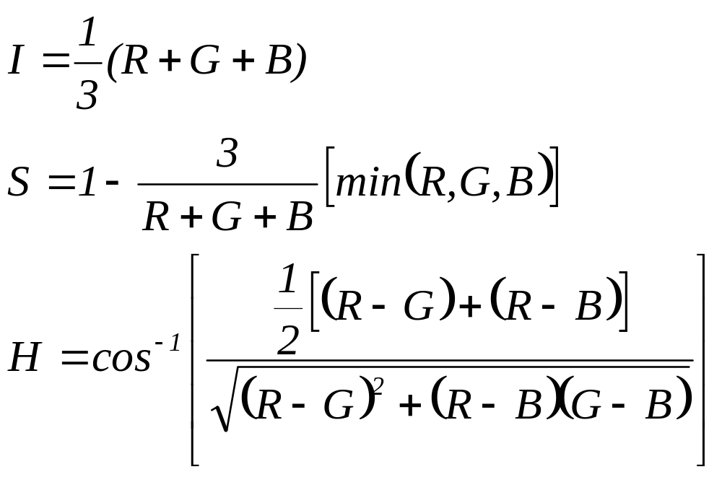
Converting between RGB and HSI
If B is greater than G, then H = 360⁰ – H.

Slide 19
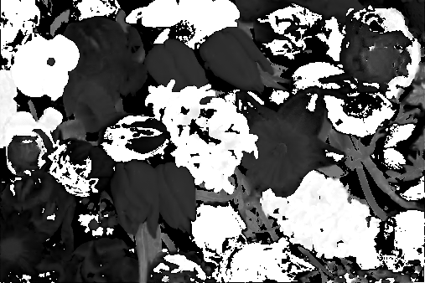
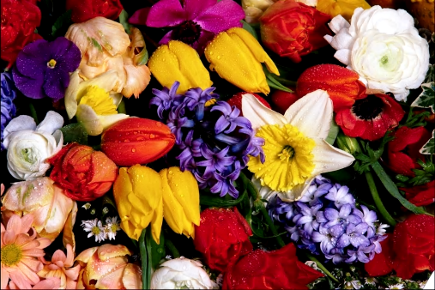
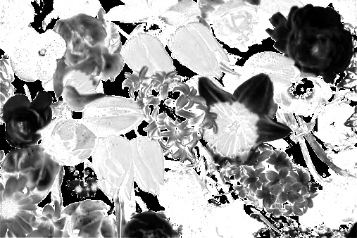
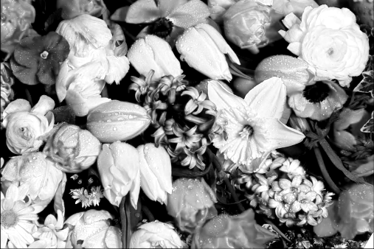
HSI Color Model
H
S
I

Slide 20
Pseudocoloring
Artifical coloring (PseudoColoring) can often enhance the presentation of image information
Replaces the gray-scale levels by an arbitrarily selected palette or color bar
Dr. M. S. Uddin, CSE Dept, JU

Slide 21
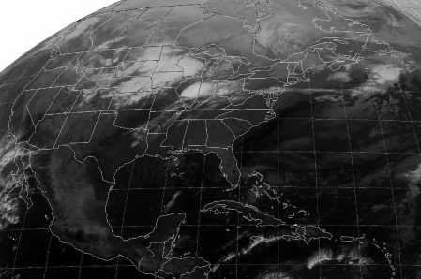
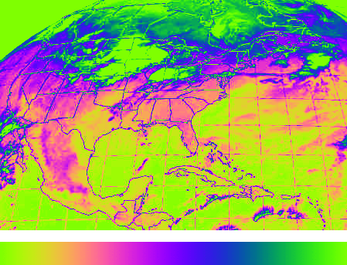
Pseudo Coloring Example
Weather satellite image. Note the way the colorized image brings out certain details that are difficult to distinguish in the original.
Dr. M. S. Uddin, CSE Dept, JU

Slide 22
Acknowledgement
Prof. Dr. Mohammad Shorif Uddin
Dept. of CSE
Jahangirnagar University

Slide 23

THANKS…

